Slide 1
GUARDIAN VISIBILITY
Reefer Airflow System
Two-Zone Temperature Monitoring for Complete Cold Chain Visibility
Technical Documentation · Training Materials
SOLO 5G
Return Air
BEACON
Chute Outflow

Slide 2
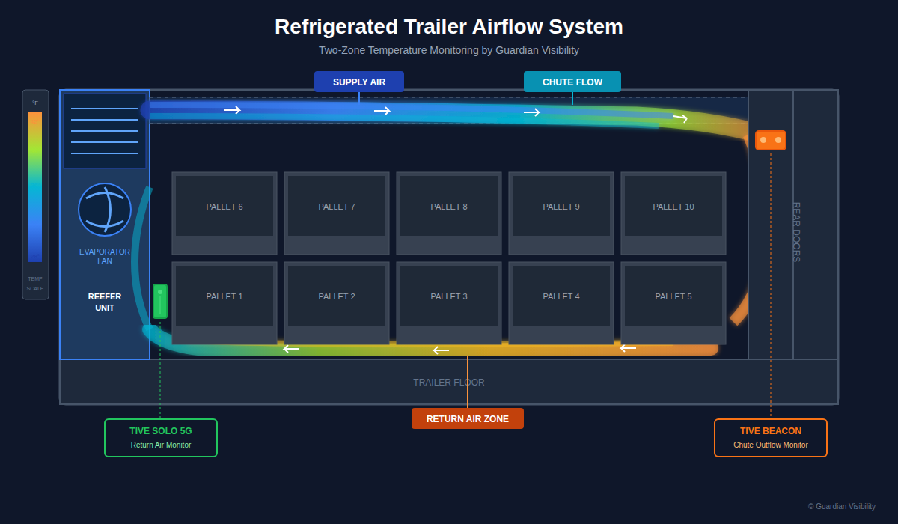
Technical Diagram - Engineering Reference
Keynote / Presentation Version

Slide 3
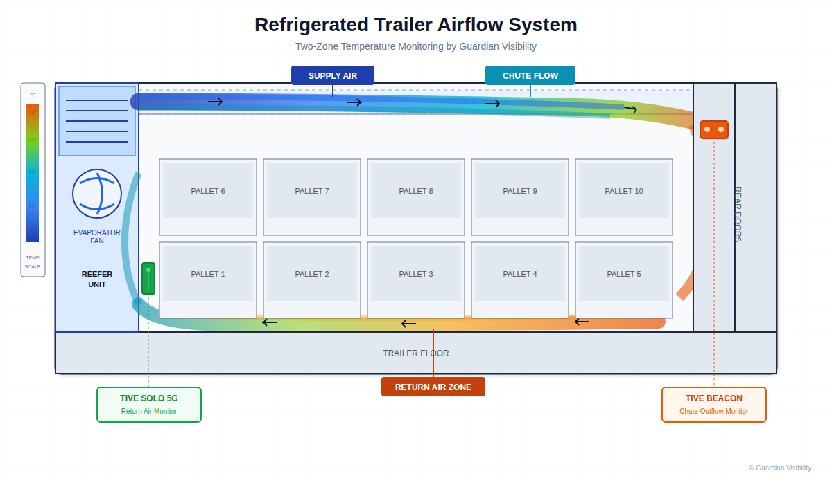
Technical Diagram - Print Version
White Background - Optimized for Print

Slide 4
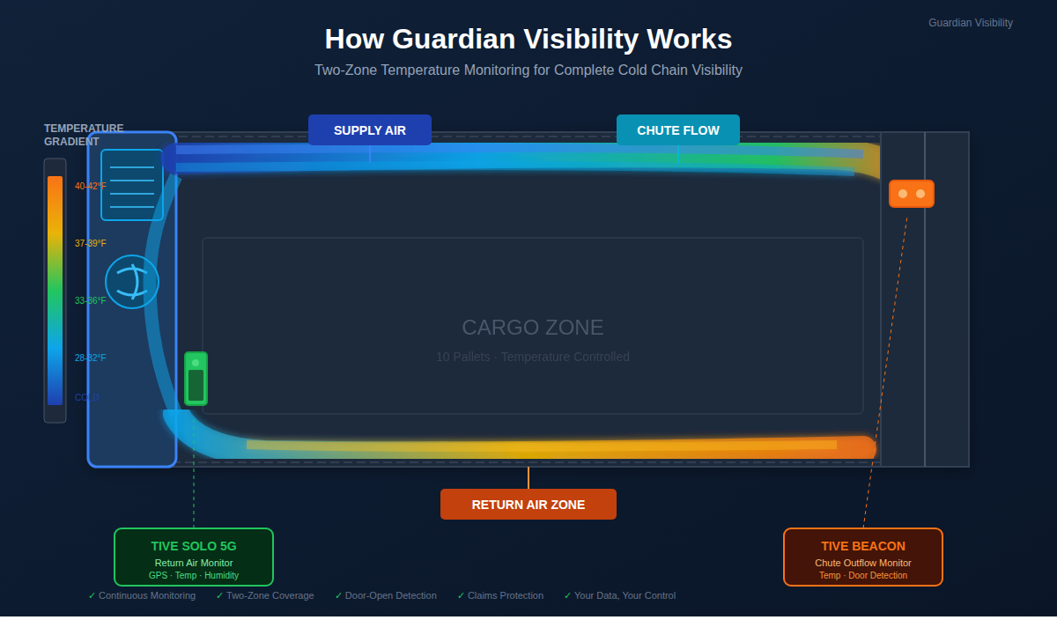
How Guardian Visibility Works
Sales & Marketing Version

Slide 5
Temperature Gradient Scale
Understanding the color-coded temperature visualization
28-32°F
Deep Blue
Coldest - Supply Air from Evaporator
33-36°F
Light Blue
Cold - Chute Flow Zone
37-39°F
Cyan
Neutral - Transitional Zone
40-42°F
Light Orange
Warm - Return Air Zone
Physics: Cold air (denser) flows along the ceiling chute, warms as it absorbs heat from cargo, then returns along the floor to the evaporator intake. This creates a continuous circulation loop.

Slide 6
Why Two-Zone Monitoring Matters
✓
Continuous Monitoring
No gaps in temperature data throughout transit
✓
Two-Zone Coverage
Supply air AND return air temperatures captured
✓
Door-Open Detection
Beacon monitors airflow changes at rear doors
✓
Claims Protection
Better data than reefer downloads for dispute resolution
✓
Your Data, Your Control
Carrier-owned equipment means you own the data
Learn more at guardianviz.com · (406) 430-6100

